Slide 1

Create A eBook App using Flutter
COLLEGE OF COMPUTING SCIENCES AND INFORMATION TECHNOLOGY
TEERTHANKER MAHAVEER UNIVERSITY, MORADABAD
BACHELOR OF TECHNOLOGY (CSE-IBM)
PROJECT GUIDE: Dr. Shalini Ninoria Associate Professor, CCSIT,TMU Mr. Anurag Gupta Assistant Professor,CCSIT,TMU | SUBMITTED BY: Aditya Jain(TCA1857003) BTECH CSE-IBM VIIIth Semester

Slide 2
Project Title
Title: Create a eBook app using Flutter.
Domain
Flutter

Slide 3
Project Description
As we all know one cannot carry a physical book all around so we have created this eBook App.eBooks can be downloaded and stored for later use. One can carry the eBook around and read them whenever they want. Students and employees can go through the learning material while at home and even while travelling. It is convenient for people on the go. eReaders come with the option of offline accessibility, allowing people to use it even in the absence of an internet connection.
A Flutter app to Read and Download books. The Books included in the app are from the Public Domain. The Feed books API was used to fetch books.

Slide 4
Scope of the project
This app will contain various tasks such as reading eBooks and making them offline.Also it will include dark mode for user to read it easily and correctly.Also it will contain many free eBooks so that user do not need to pay for it.Also it has the option to favourite your eBook.

Slide 5
Project Modules
It mainly contains 5 files:
Main.dart: It is the home of our App containing the code.
Downloads.dart: Logic and plugin to download the eBook
Details.dart: Contains information about the eBook.
Splash.dart: Contains boot animations.
Api.dart: Contains API information

Slide 6
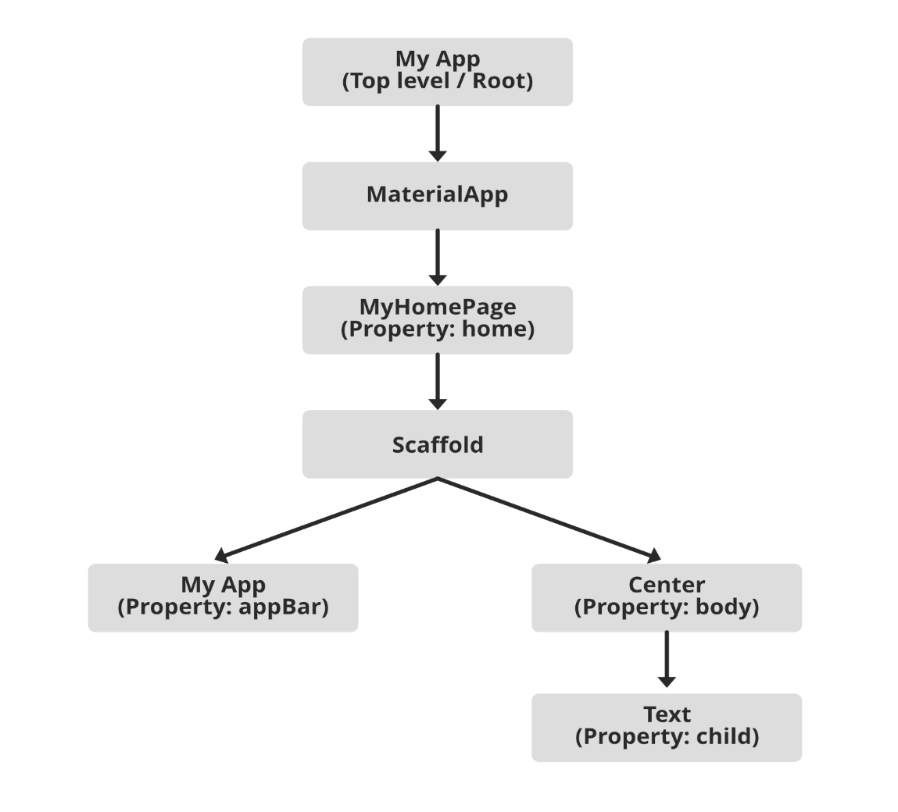
Implementation Methodology

Slide 7
Advantages of This Project
eBooks are portable and lightweight, making it easy to carry around. Instead of carrying multiple bulky books, one eBook reader can hold thousands of eBooks. It saves a lot of space- in your home and in your bag. One doesn’t have to worry about the storage limit. You can share the eBook contents with multiple users. The social feature on the ebook allows sharing and liking of content, which is not possible with printed books. You might share a printed book with one person at a time, but an eBook can be shared with many people at once. Students and employees can use this feature to collaborate with their peers.
Including interactive features in an eBook makes the reading experience a more engaging one. eBooks can be embedded with audio and videos. External links can be included to offer additional information. The user can even bookmark a certain page or find a word in a quick and effortless way. It also allows users to make annotations. There are multiple such interactive features which can be included in order to enhance the overall reading experience.

Slide 8
Future Scope and Future Enhancements of This Project
Since Flutter is a Google offering, it’s fully supported by Google’s Material Design team. Due to this support, Flutter app development becomes a lot easier, even for beginners. The framework comes with exhaustive documentation to help developers start a project. The documentation is in-depth and allows developers to resolve all challenges they can encounter during the project.
As discussed, Flutter enables you to use a single codebase to develop cross-platform applications. Hence, it significantly reduces the time and effort you need to invest in app development. Furthermore, it uses Dart programming a language, which focuses on ease of use and usability.
In this hyper-competitive business landscape, the quicker you can get your product to the market, the better chances you have of succeeding. A quicker time-to-market can help you reach your target customers before your competitors, get feedback quickly, and upgrade your product as per the requirements. Since Flutter app development and testing is less time-consuming and resource-intensive, you can get your app to market in less time. As a result, you can develop a significant edge over your competitors, get more sales, and increase profits for your business.

Slide 9
Conclusion
So, this the final app made from flutter and it contains many features and more will be added in the future as well.When developing a mobile app, the cost of development is something you can’t overlook. The average cost of developing a mobile app is around $30,000. And of course, depending upon the requirements, the cost can go as high as $100,000. Startups and smaller businesses don’t have such a large financial backing. Moreover, the cost of development isn’t all. You also need to consider additional expenses like team building, server cost, marketing, and more. Flutter largely reduces the cost of development. Thanks to the single codebase, you don’t need platform-specific developers. You can hire Flutter developers [Remove Highlight] and develop cross-platform applications. Since the testing requirements are also low, you can get a cross-platform app up and running even if you have a low budget.

Slide 10


